Slide 1
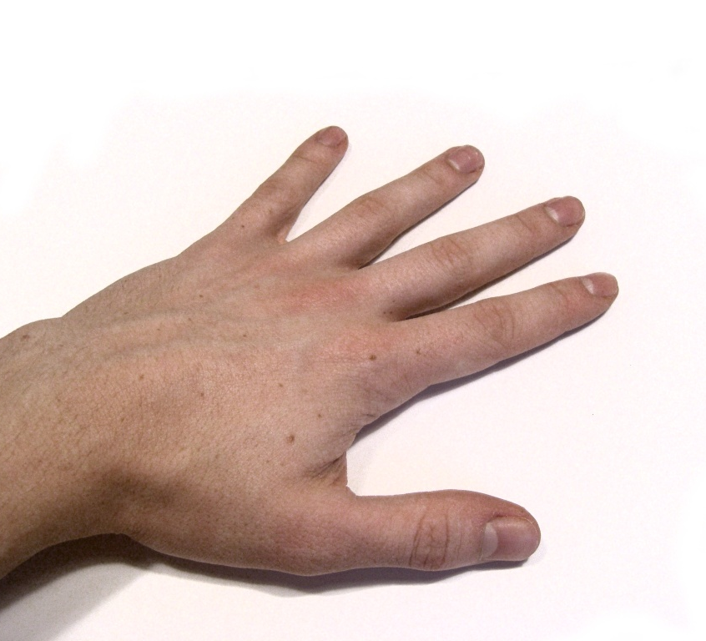
GESTURE JESTER
BUILD, Test and enable your own Hand Gesture Recognition system
Dylan Mendonca

Slide 2
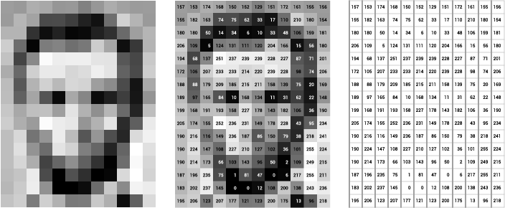
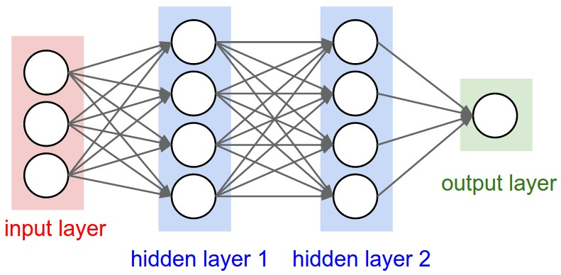
Gesture Jester recognizes hand gestures in real-time using the power of Neural Networks
Neural Networks
Consist of layers
Each layer uses fancy math to convert data to complex forms
Output layer gives you a final answer (probability, a number, etc.)
Requires training
Convolutional Neural Network is most frequently used architecture for image recognition
Inputs are pixel values
Outputs are probabilities of each gesture happening
Final answer is the one with the highest probability

Slide 3

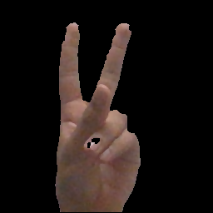
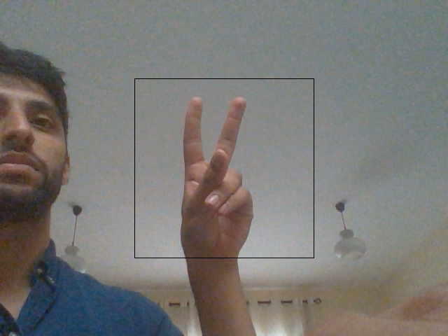
OpenCV (Fancy Photoshop for Coders) Helped Build the Dataset
Created a Region of Interest (ROI)
Capture the background
Create a background mask
Use thresholding to create a binary
Capture data

Slide 4
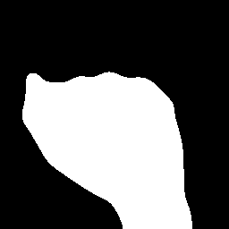




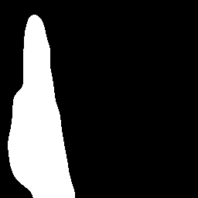


Captured 1000 Training Images for 8 Unique Gestures
Fist
Five
None
Okay
Peace
Straight
Rad
Thumbs

Slide 5

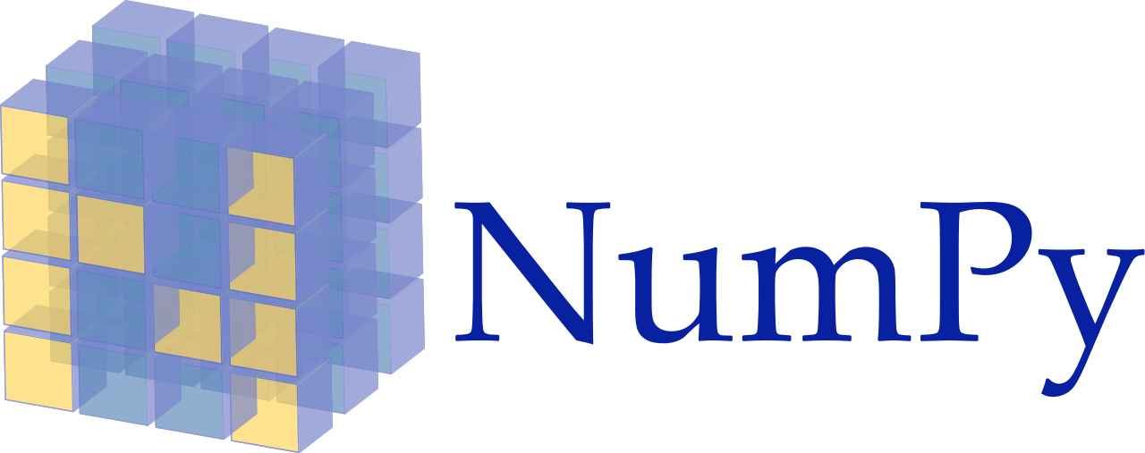


Trained, Validated and Tested Model using Keras on Kaggle’s Cloud Platform
Convert Images to NumPy Arrays
Designed a CNN Network Using Keras
Trained Model on Kaggle Cloud Platform
Evaluated on 500 validation images and 500 test images
Test Accuracy: 99.8%

Slide 6

Created a PyGame Music Application and Triggered Commands Using 6 Gestures
Created Music App using PyGame
Created Gesture Bindings
Gestures Used:
Rad: Loads Song
Fist: Plays/Un-pause Song
Five: Pause Song
Okay: Increase Volume
Peace: Decrease Volume
Straight: Stop Song
None: Do Nothing

Slide 7
DEMO

Slide 8
There are a few improvements to be made…
Recognize any hand without using background subtraction
Need a lot more training data
Use Pre-trained Models
Recognize Dynamic Gestures
Integrate Model with Alexa or Google Home

Slide 9

QUESTIONS

